Slide 1


Mastering Multithreading in .NET: From Basics to Concurrency Architect
Bhushan Poojary

Slide 2
Multithreading
What you will learn ?
What you all NEED?
Why Multithreading ?

Slide 3
Why Multithreading?
Multithreading is Key to Performance
Real-World Applications: | By the end of this course, you will:
Responsive UI applications Efficient background services Scalable backend systems | Understand how threads work Know when and why to use concurrency Avoid common multithreading pitfalls Write thread-safe, reliable code

Slide 4

Why Multithreading?
"Concurrency is not just about performance—it's about writing smarter, more resilient software."

Slide 5
What You'll Learn
What You'll Learn
Thread basics and life cycle
Synchronization and locks
Thread pool vs Task-based concurrency
async/await best practices
Capstone project and interview prep
Patterns, pitfalls, and real-world examples

Slide 6
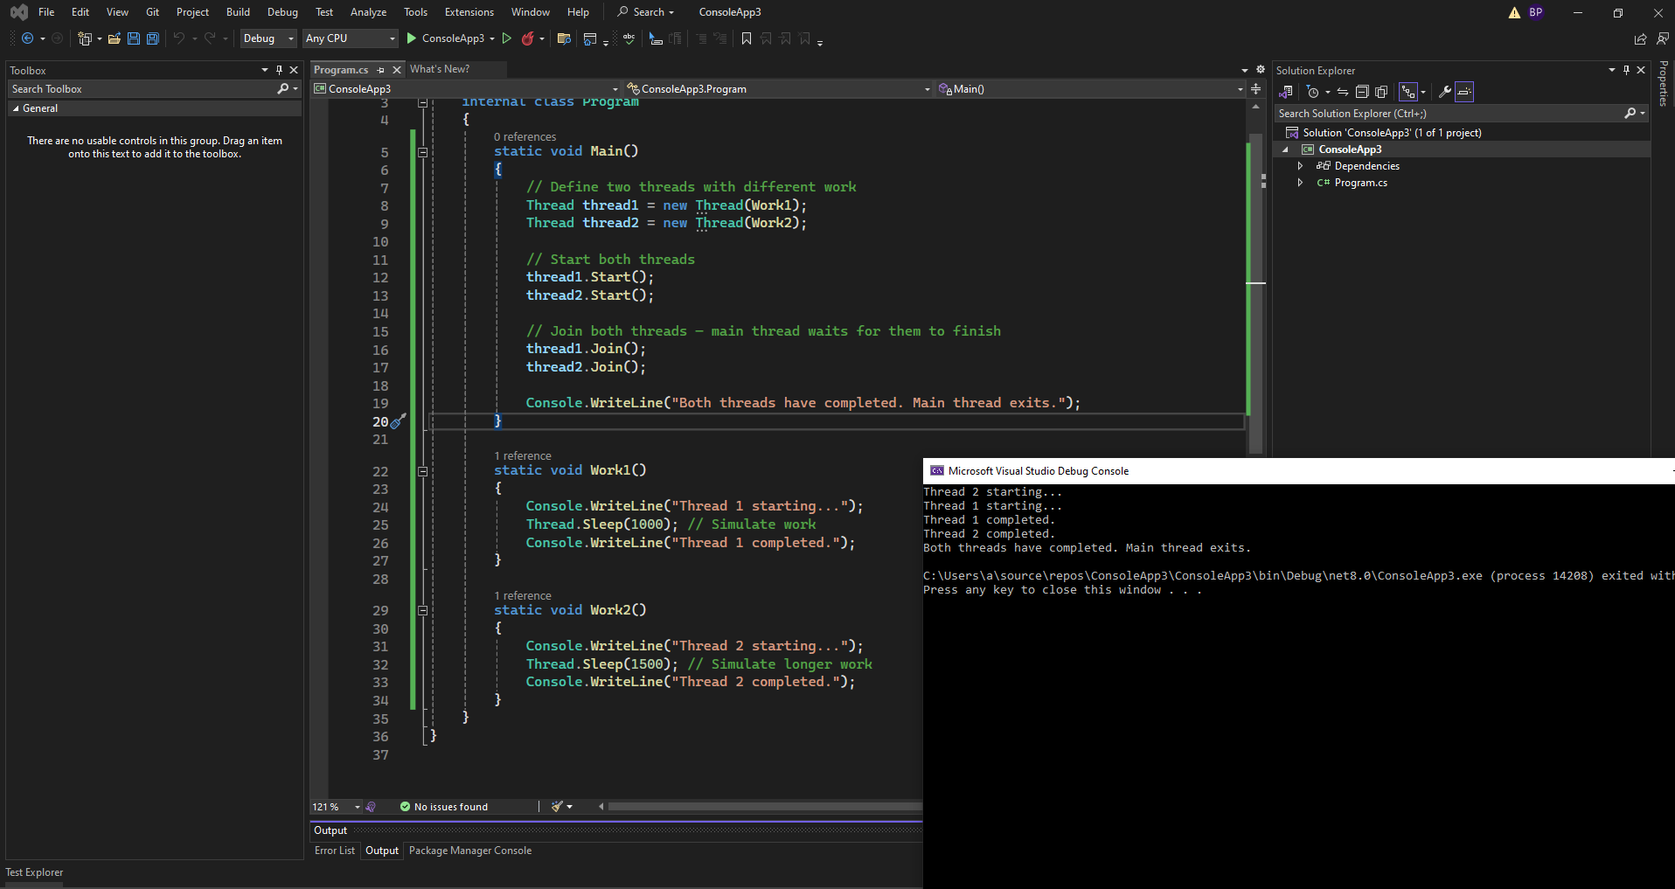

Code and Quiz

Slide 7

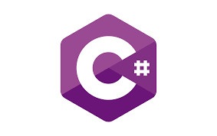
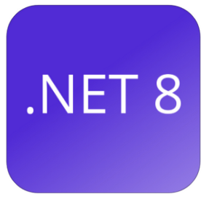
What You’ll Need
What You’ll Need
C#
Visual Studio 2022
.NET SDK 8.0

Slide 8

Resources
https://github.com/bhushanpoojary/MultiThreadingDotNet

Slide 9
See You in the Next Module!
"I'm excited to be your guide on this journey. Let’s dive into the world of multithreading and make your .NET apps faster and smarter. See you in the next module!"

Slide 10
Setting up the environment (Visual Studio, .NET SDK)
Name | Url
Visual Studio Community 2022 | https://visualstudio.microsoft.com/vs/community/
.NET SDK 8 | https://dotnet.microsoft.com/en-us/download/dotnet/8.0

Slide 11

Thread
Thread thread = new Thread(() =>
{
Console.WriteLine("Running in a separate thread");
});
thread.Start();
 | Pros and Cons
 | More control (e.g., priority, abort)
 | Higher overhead than thread pool

Slide 12
Thread Pool
In .NET, a Thread Pool is a pool of worker threads managed by the CLR (Common Language Runtime) that are used to perform tasks, process asynchronous calls, handle timers, and manage other background operations without the overhead of creating and destroying threads manually.
Key Characteristics:
Managed by .NET runtime: You don't need to create or destroy threads manually.
Reuses threads: It reuses threads to avoid the overhead of frequent creation and destruction.
Limits the number of concurrent threads: Prevents system overload by restricting the number of active threads.
Efficient for short-lived operations: Ideal for I/O-bound or short-running tasks.

Slide 13
Thread Pool
ThreadPool.QueueUserWorkItem(state =>
{
Console.WriteLine("Running in thread pool");
});

Slide 14
Thread Pool
How many threads are there at max in thread pool in given time in C# ?
ThreadPool.GetMaxThreads(out int workerThreads, out int completionPortThreads); ThreadPool.SetMaxThreads(100, 100);
How many threads are created by default minimum for a process ?
ThreadPool.GetMinThreads(out int workerThreads, out int completionPortThreads);
ThreadPool.SetMinThreads(8, 8); // Increases readiness to spawn more threads
How many threads are created by default minimum for a process ?
ThreadPool.GetMinThreads(out int workerThreads, out int completionPortThreads);
Worker threads: 1 × number of logical processors
I/O completion threads (IOCP): 1 × number of logical processors

Slide 15
Thread Pool
// Step 2: Offload email sending to ThreadPool
ThreadPool.QueueUserWorkItem(state =>
{
SendEmailConfirmation((Order)state);
}, order);
Why ThreadPool is a good fit here:
Email sending is a short-lived, non-blocking task.
ThreadPool reuses threads — no overhead of creating new threads each time.
It’s fire-and-forget — you don’t need a return value or error handling in the main thread.

Slide 16
Cons Thread Pool
No return value or result tracking
Unlike Task<T>, you can’t get the result of the operation.
No built-in way to await the completion.
No built-in error handling
If an exception occurs in the thread pool thread, it may go unobserved and crash the process unless handled carefully.
No cancellation support
You can’t easily cancel the work once it’s queued.
No fine-grained control
You can’t set thread priorities, thread affinity, or custom scheduling behavior.
Limited to short-lived tasks
ThreadPool is designed for fast, short tasks. Long-running tasks can block thread pool threads and exhaust available threads.
Difficult debugging and tracing
Since the threads are pooled and reused, stack traces and debugging behavior can be harder to follow.
No dependency injection or scoped lifetime support
In ASP.NET Core, ThreadPool threads don’t have access to scoped services. Using them can lead to service lifetime violations.

Slide 17
Why was Task introduced?
Threads: Manual, heavy, and harder to manage (e.g., synchronization, pooling, exceptions).
ThreadPool: Lightweight, reusable threads, but limited flexibility and control.
Tasks (via TPL - Task Parallel Library) were introduced in .NET 4.0 to:
Simplify asynchronous and parallel programming.
Use thread pool threads efficiently under the hood.
Provide a high-level abstraction over threads with more control,
cancellation, continuations, exception handling, and composability.
🧠 Analogy: If a Thread is like creating a new worker every time,
a Task is like managing a group of pre-hired workers via a smart manager (ThreadPool + TPL).

Slide 18
Basic Thread vs Task Comparison
Thread | Task
new Thread(() => { Console.WriteLine("Running in a Thread"); }).Start(); | Task.Run(() => { Console.WriteLine("Running in a Task"); });
Benefits of Task
Task is simpler.
Runs on ThreadPool.
Returns a Task object, allowing you to Use .ContinueWith() Await the result (await) Handle exceptions easily Use cancellation tokens

Slide 19
Real-World Use Case of Task
Task t1 = Task.Run(() => DownloadFile("file1.txt"));
Task t2 = Task.Run(() => DownloadFile("file2.txt"));
await Task.WhenAll(t1, t2);

Slide 20
Why Task over Thread Today
Why Task over Thread Today
Less error-prone (try catch , cancelation token, async await more readable)
More scalable (less overhead , Thread pool)
Integrates with async/await.
Built-in support for performance optimization and system resource reuse.

Slide 21
What Does an Async Method Really Return?
Method Signature
async Task<string> DownloadContentAsync()
async keyword: tells compiler to enable await.
Task<string>: promises a future string, not a string right now.
Return type is a Task, not a direct value.
📌 “This method returns immediately with a task that completes later.”

Slide 22
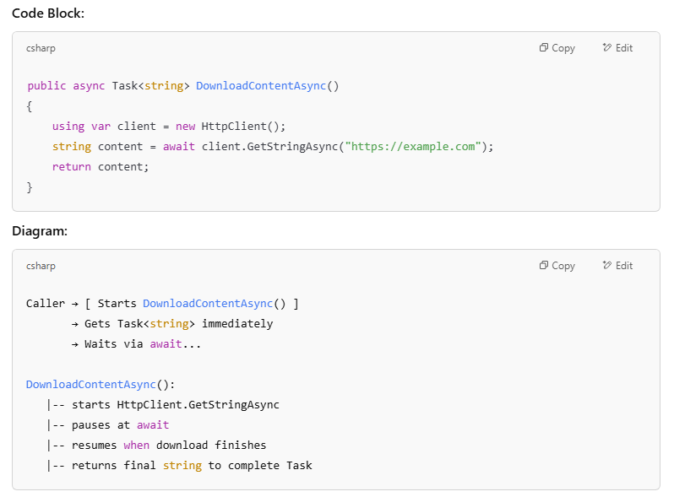
Inside the Method

Slide 23
Return Flow Explanation
.
return content ≠ returning a string
return content; completes the Task<string> with actual result.
Control goes back to caller after the await completes.
Caller uses await to unwrap the final result

Slide 24
Real-Life Analogy
Baking Analogy (Async Return)
You order a cake 🧁 → You get a buzzer 🔔 (Task)
Buzzer rings when cake is ready → You eat 🍰 (await gets string)
Task<string> is like a buzzer that goes off when your data (string) is ready!"

Slide 25
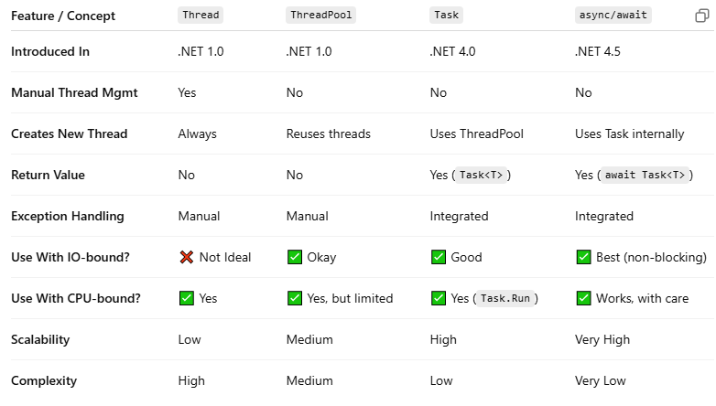
Comparison Table

Slide 26
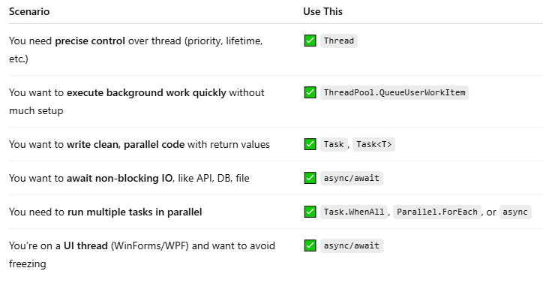
When to Use What

Slide 27
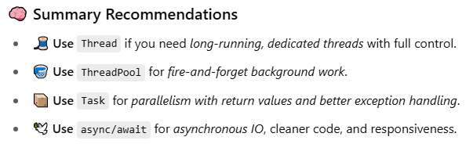
Summary recommedations

